Slide 1
Similarity

Slide 2
What is similarity?
Notes:
http://shirtoid.com/20983/brainstorm/

Slide 3
Notes:
https://www.aliexpress.com/w/wholesale-volkswagen-beetle-model.html
http://bringatrailer.com/listing/1965-vw-beetle/
http://paperlandmarks.storenvy.com/collections/158404-pre-cut-kits/products/878015-eiffel-tower-paper-model-craft-kit
https://www.parisianist.com/en/attractions/monuments/eiffel-tower

Slide 4
Notes:
https://www.mapsofworld.com/australia/

Slide 5

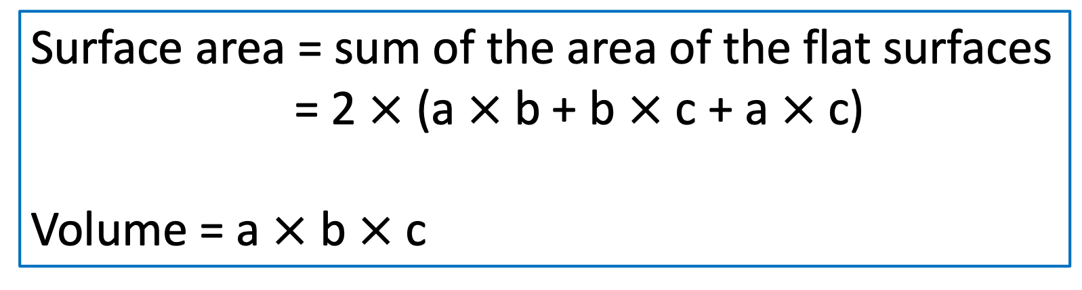
Calculate the surface area and volume for the rectangular prism (cuboid) below for the various dimensions listed.
c
b
a
Surface area = sum of the area of the flat surfaces
= 2 $×$ (a $×$b + b $×$c + a $×$c)
Volume = a $×$ b $×$ c

Slide 7
(1 : 2²)
(1 : 3²)
(1 : 2³)
(1 : 3³)
Prisms 2 and 3 is the enlargement of Prism 1. It can be summarised that
Lengths original : length in enlargement = 1 : k
Surface area (original) : surface area (enlargement) = 1 : k²
Volume (original) : volume (enlargement) = 1 : k³
k = the scale factor of enlargement

Slide 8
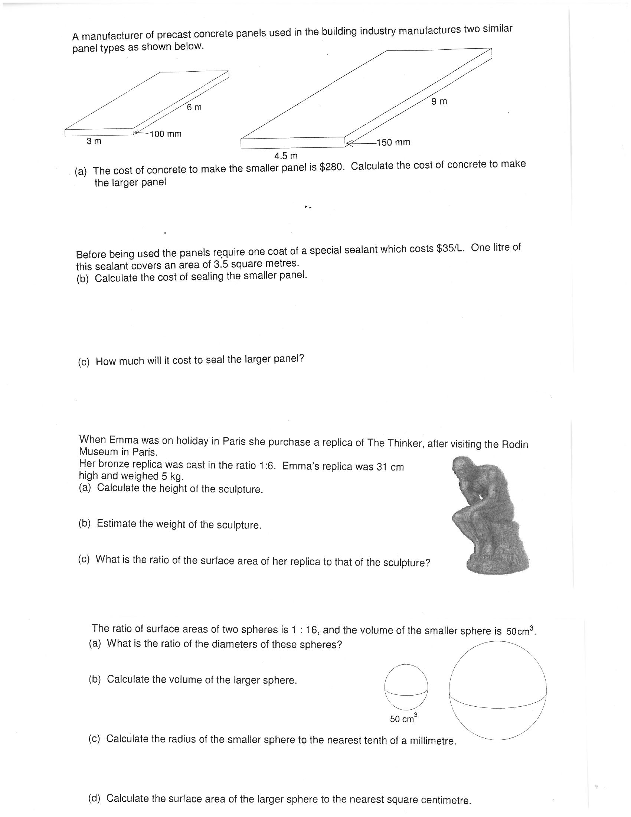
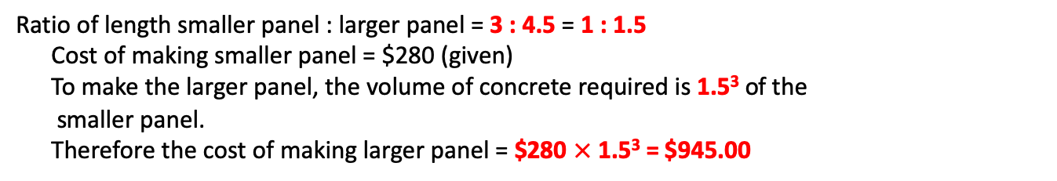
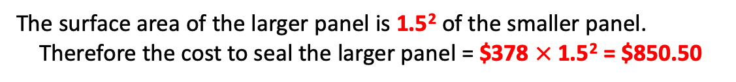
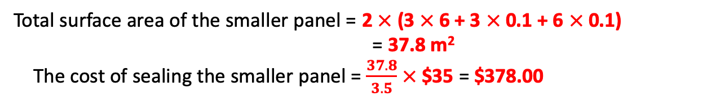
Ratio of length smaller panel : larger panel = 3 : 4.5 = 1 : 1.5
Cost of making smaller panel = $280 (given)
To make the larger panel, the volume of concrete required is 1.5³ of the
smaller panel.
Therefore the cost of making larger panel = $280 $×$ 1.5³ = $945.00
Total surface area of the smaller panel = 2 $×$ (3 $×$ 6 + 3 $×$ 0.1 + 6 $×$0.1)
= 37.8 m²
The cost of sealing the smaller panel = $\frac{37.8}{3.5}$ $×$$35 = $378.00
The surface area of the larger panel is 1.5² of the smaller panel.
Therefore the cost to seal the larger panel = $378 $×$ 1.5² = $850.50

Slide 9
Notes:
http://au.phaidon.com/the-art-book/articles/2012/november/12/artist-of-the-week-auguste-rodin/

Slide 10
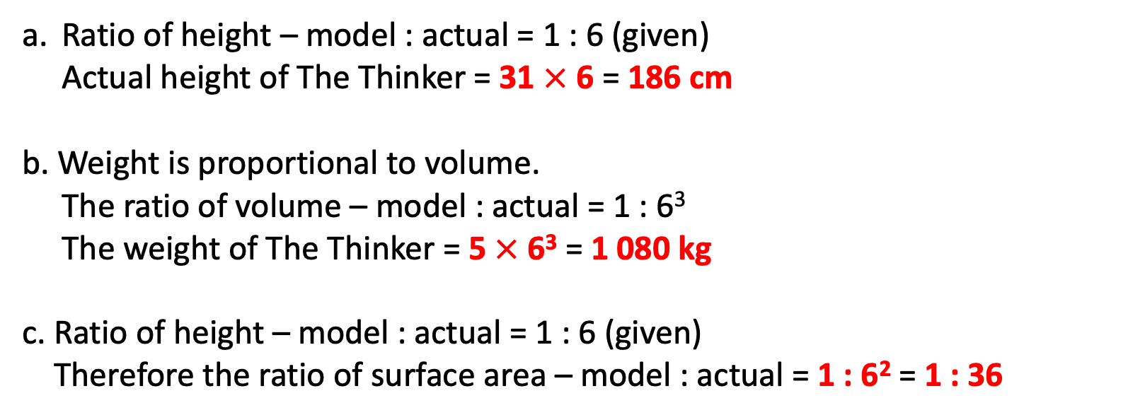
Ratio of height – model : actual = 1 : 6 (given)
Actual height of The Thinker = 31 $×$ 6 = 186 cm
b. Weight is proportional to volume.
The ratio of volume – model : actual = 1 : 6³
The weight of The Thinker = 5 $×$ 6³ = 1 080 kg
c. Ratio of height – model : actual = 1 : 6 (given)
Therefore the ratio of surface area – model : actual = 1 : 6² = 1 : 36
Notes:
http://au.phaidon.com/the-art-book/articles/2012/november/12/artist-of-the-week-auguste-rodin/

Slide 11
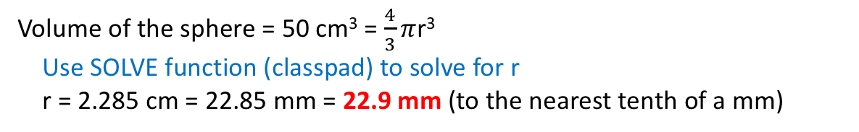
Ratio of surface area – small : large = 1 : 16 (given) = 1 : 4²
Therefore the ratio of radius – small : large = 1 : 4
The volume of the larger sphere = 50 $×$ 4³ = 3 200 cm³
Volume of the sphere = 50 cm³ = $\frac{4}{3}π$r³
Use SOLVE function (classpad) to solve for r
r = 2.285 cm = 22.85 mm = 22.9 mm (to the nearest tenth of a mm)
Surface area of the smaller sphere = 4$π$r² = 4 $π$ (2.285)²
SA of the larger sphere = 4 $π$ (2.285)²$×$16 = 1 050 cm² (nearest square cm)

